Slide 1
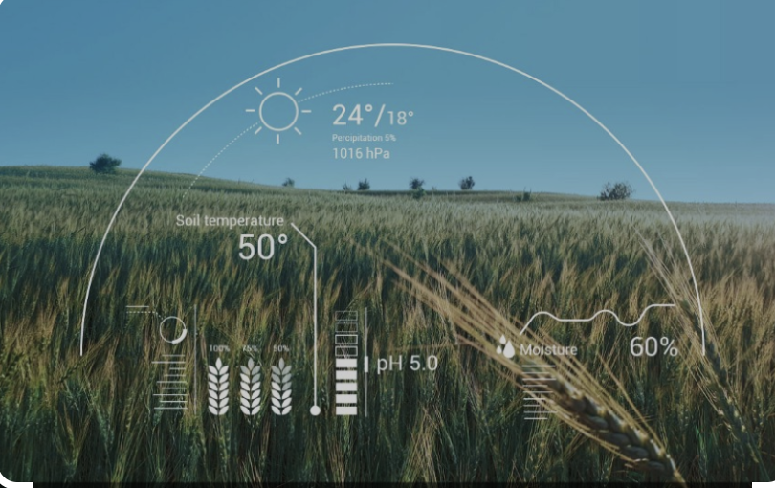
Crop prediction based on environmental factors
By
1)ARPIT VATS(RA2211003010655)
2)ASISH VARMA.J(RA2211003010645)
3)ADARSH VATS(RA2211003010652)

Slide 2
Abstraction:
Accurate crop yield prediction is crucial for ensuring food security and effective agricultural planning. This study proposes a machine learning-based approach to predict crop yields by leveraging environmental factors. The growing global population and changing climatic conditions emphasize the need for innovative solutions in agriculture. Traditional methods of yield prediction often lack precision due to their inability to capture complex interactions between crops and their environment
a comprehensive dataset encompassing various environmental parameters such as temperature, humidity, precipitation, soil characteristics, and historical crop yields is collected and preprocessed.
The results demonstrate that machine learning models can significantly improve the accuracy of crop yield prediction compared to traditional methods. The selected model achieves high predictive performance, providing farmers, agricultural policymakers, and stakeholders with valuable insights to make informed decisions. The proposed approach not only enhances yield prediction accuracy but also aids in identifying optimal conditions for various crops, contributing to sustainable agricultural practices.
In conclusion, this research highlights the potential of machine learning techniques in predicting crop yields based on environmental factors. By harnessing the power of data-driven insights, this approach can revolutionize agricultural practices, fostering increased efficiency, reduced waste, and improved resource allocation in the face of evolving environmental challenges.

Slide 3
What we are going to do in this project?
In this k-NN classification algorithm is used,which means k nearest neighbours .K-Nearest Neighbour is one of the simplest Machine Learning algorithms based on Supervised Learning technique.
K-NN algorithm assumes the similarity between the new case/data and available cases and put the new case into the category that is most similar to the available categories.
In the proposed study on "Crop Prediction Based on Environmental Factors using Machine Learning," several key steps will be undertaken to achieve accurate and reliable crop yield predictions. The outline of the research process includes:
Data Collection and Preprocessing:
Gathering a comprehensive dataset that includes historical crop yield data and various environmental parameters such as temperature, humidity, precipitation, soil attributes, and more.
Cleaning and preprocessing the dataset to handle missing values, outliers, and inconsistencies that might affect the quality of predictions.
Feature Selection and Engineering:
Identifying the most relevant environmental factors that have a significant impact on crop yields through statistical analysis and domain knowledge.
Performing feature engineering to transform, normalize, or combine features, enhancing the models' ability to capture complex relationships.
Interpreting Model Insights:
Analyzing feature importance scores from models like decision trees and random forests to understand the contribution of each environmental factor to crop yield variations.
Identifying patterns, trends, and interactions among different factors that impact crop yields.
Forecasting and Prediction:
Utilizing the selected machine learning model to make predictions for future crop yields based on upcoming environmental conditions.
Validating the predictions against actual yield outcomes to assess the model's accuracy in real-world scenarios.
Communication and Application:
Presenting the findings, insights, and predictions to farmers, agricultural experts, policymakers, and stakeholders in a comprehensible and actionable manner.
Providing recommendations for optimal planting strategies, resource allocation, and risk management based on the predictive model's outcomes.
Impact and Significance:
Highlighting the potential benefits of accurate crop yield predictions for improved agricultural planning, resource management, and food security.
Discussing the role of data-driven insights in addressing challenges posed by changing climatic conditions and population growth.
Overall, the research aims to showcase the feasibility and effectiveness of using machine learning techniques to predict crop yields by leveraging environmental factors. The results of this study have the potential to revolutionize agricultural practices, supporting sustainable and efficient farming methods while adapting to the evolving complexities of the environment.

Slide 4
Literature review reasearch
A literature review on crop prediction based on environmental factors using machine learning reveals a significant body of research focusing on improving agricultural practices through data-driven approaches. Here are some key studies and trends in this field:
Crop Yield Prediction Models:
Research by Azzari et al. (2017) explored the use of satellite data and machine learning algorithms to predict crop yields, considering environmental factors such as weather conditions and soil moisture. They demonstrated the effectiveness of support vector machines and random forests in predicting crop yields accurately.
Climate Impact Studies:
Lobell and Field (2007) conducted a study on the sensitivity of crop yields to changes in temperature and precipitation. Their work highlighted the vulnerability of agriculture to climate change and the need for predictive models to mitigate potential negative impacts.

